Slide 1
Changes to make next time:
Will eventually remove DTU stuff?
Does this cover Managed Instance?!
Remove the features section. I don’t need to talk about indexes and In-mem. Not here.
Add demo for scaling. I have the script in PowerShell!!!!
Add Query Store slide right before QPI
Better demo to query WWI with ostress to show more about QPI
Can I find bad queries somewhere? If not, I just need to write more.
Show more about Automatic Tuning
Will need to add more about Auto Scaling eventually.

Slide 2
Azure SQL Database Performance Tuning

Slide 3

Jes Schultz Software Engineer Microsoft jes.schultz@microsoft.com @grrl_geek LessThanDot.com

Slide 4
Let’s talk about
Paying for performance
Monitoring
Indexes
In-Memory OLTP
Columnstore Indexes
Scaling
Query Performance Insight
Automatic Tuning

Slide 5
Agenda
Paying for performance
Know how much work your queries do
Monitor your resource consumption
Use features for performance
Scaling
Learn about your workload

Slide 6
Paying for performance

Slide 7
How we measure (and pay for) performance in SQL Database
DTU
Vcore
Notes:
What is it?
How many will I need?

Slide 8
DTU - Database Throughput Units
“A blended measure of CPU, memory, I/O (data and transaction log I/O)”
Guaranteed performance
When workload exceeds one of those resources, throughput is throttled
For Single Database and Elastic Pools
DTU
Notes:
https://docs.microsoft.com/en-us/azure/sql-database/sql-database-what-is-a-dtu
https://docs.microsoft.com/en-us/azure/sql-database/sql-database-benchmark-overview

Slide 9
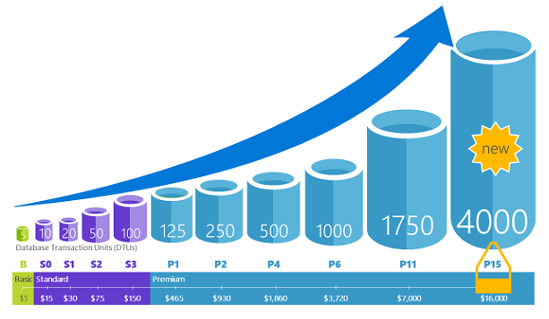
Notes:
Scaling up through tiers
Basic - B – 5
Standard –S1 – S12 – 10-3,000
Premium – P1 – P15 – 125-4,000

Slide 10
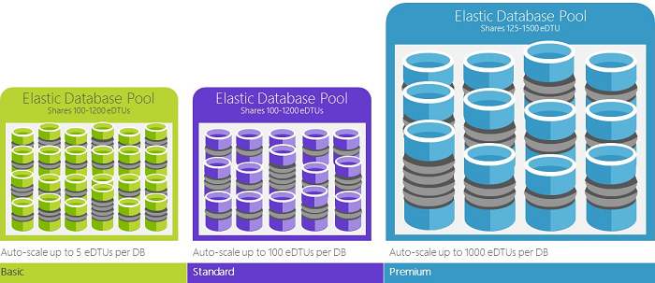
Notes:
Basic 50 – 1,600
Standard 50 – 3,000
Premium – 125 – 4,000

Slide 11
How many DTUs do I need?
Migrating workloads
DTU Calculator - http://dtucalculator.azurewebsites.net/
New workloads
Start low, work up

Slide 12
Vcore
Scale CPU/memory separately from storage
Gen 4 - Intel E5-2673 v3 (Haswell) 2.4 GHz processors
Gen 5 - Intel E5-2673 v4 (Broadwell) 2.3-GHz and Intel SP-8160 (Skylake) processors
General Purpose |  | Business Critical
Gen 4 | Gen 5 | Gen 4 | Gen 5
1-24 cores | 2-80 cores | 1-24 cores | 2-80 cores
7 GB per vCore | 5.1 GB per vCore | 7 GB per vCore | 5.1 GB per vCore
5GB – 4TB Premium blob storage |  | 5GB – 4TB local SSD storage
Vcore

Slide 13
How can maximize your investment?

Slide 14
Know how much work your queries do

Slide 15
How expensive are my queries?
Plan cache and execution plans are the same as SQL Server!
SentryOne Plan Explorer works for SQL DB, too!
You can track query performance and history using Query Store
Notes:
Screenshots?

Slide 16
Monitor your resource consumption

Slide 17
DMVs
sys.dm_db_resource_stats
Per database
Captures data every 15 seconds
Stored for one hour
Shows percentage used of allowed DTU limits for current tier
sys.resource_stats
Stored in master database
Captures data every 5 minutes
Stored for 14 days
Shows percentage used of allowed DTU limits for current tier
Notes:
sys.dm_db_resource_stats https://docs.microsoft.com/en-us/sql/relational-databases/system-dynamic-management-views/sys-dm-db-resource-stats-azure-sql-database
Sys.resource_stats https://docs.microsoft.com/en-us/sql/relational-databases/system-catalog-views/sys-resource-stats-azure-sql-database

Slide 18
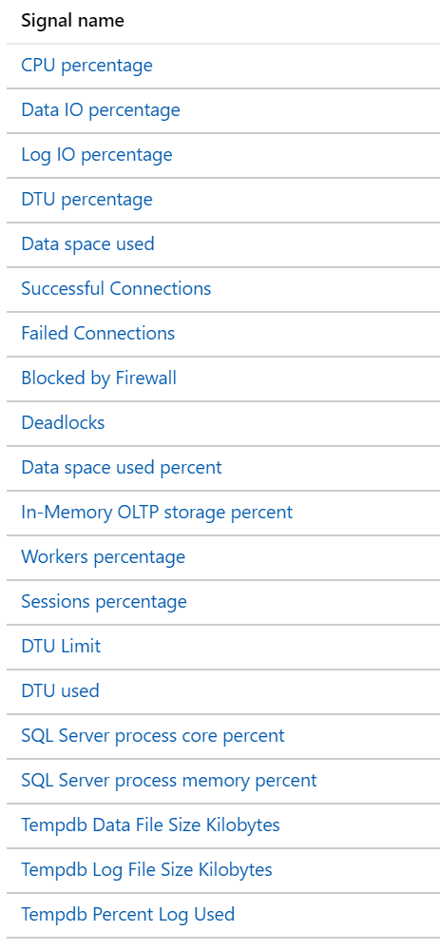
Alert rules
Monitor your databases - when set conditions are met, an email will be sent
Portal
Choose a metric
Set a condition - less than, equal to, greater than
Set a threshold
Pick a period of time the condition is evaluated for
PowerShell
Add-AzMetricAlertRule
Notes:
https://docs.microsoft.com/en-us/azure/sql-database/sql-database-insights-alerts-portal
Demo this
https://docs.microsoft.com/en-us/powershell/module/az.monitor/add-azmetricalertrule?view=azps-3.3.0

Slide 19
Use features for performance

Slide 20
A bad query is always worth tuning

Slide 21
Indexes

Slide 22
Rowstore indexes
a-z
a-k
a-c
d-k
l-z
l-n
o-t
u-z
Clustered indexes
Nonclustered indexes
Notes:
Indexes are supported and are still the primary, easiest tool for making queries run faster
I’ll talk more about indexes later, too!

Slide 23
Columnstore indexes
Segments
Available in Standard S3+ and Premium
Not just an index, but a new way to store data
Up to 10x data compression
Up to 10x query performance in data warehouse scenarios
Best for analytic queries searching large amounts of data
C1
C2
C3
C4
C5
C6
Row group
Notes:
Columnstore is a new way of storing the data
Fully supported in premium tiers

Slide 24
Columnstore flavors
Clustered columnstore index
It is the data!
Can have nonclustered rowstore indexes built on it
Nonclustered columnstore index
Built on top of a rowstore table

Slide 25
In-Memory OLTP

Slide 26
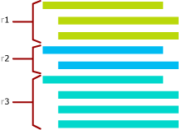
Memory is faster than disk
Memory-optimized tables
Schema or schema + data
No locking
Great for high-write workloads
Natively compiled T-SQL modules
Designed to work with memory-optimized tables for best performance
Premium tier only
1 GB storage for every 125 DTUs or eDTUs
Notes:
In-memory tables
Resource limits: https://docs.microsoft.com/en-us/azure/sql-database/sql-database-resource-limits
Case Study: Quorum doubles key database’s workload while lowering DTU by 70% with SQL Database
https://customers.microsoft.com/en-us/story/quorum-doubles-key-databases-workload-while-lowering-dtu-with-sql-database

Slide 27
Operational Analytics

Slide 28
What is operational analytics?
"An updateable columnstore index on a rowstore table or an in-memory table"
Run analytic queries – quickly! – against your transactional database

Slide 29
Scaling

Slide 30

Notes:
Scale your database up and down easily

Slide 31
How scaling works
Changing the service tier and/or performance level of a database creates a replica of the original database at the new performance level, and then switches connections over to the replica
No data is lost during this process
During the brief moment when we switch over to the replica, connections to the database are disabled, so some transactions in flight may be rolled back
The length of time for the switch over varies, but is generally under 4 seconds and is less than 30 seconds 99% of the time
If there are large numbers of transactions in flight at the moment connections are disabled, the length of time for the switch over may be longer
Notes:
https://docs.microsoft.com/en-us/azure/sql-database/sql-database-service-tiers#scaling-up-or-scaling-down-a-single-database

Slide 32
Scaling limitations
Scaling up
If you upgrade to a higher tier or level, maximum database size doesn’t change unless you specify it
If upgrading a database with DR (geo-replication) enabled, the recommendation is to upgrade the secondaries first
Scaling down
The database size must not be larger than the maximum database size for the lower tier or level
When you downgrade to a lower tier, your DR options (such as backup retention period) may change, columnstore and in-memory may not be available

Slide 33

How to scale
Portal
PowerShell
Manually
Scheduled
Notes:
DEMO
Show Portal
Open up POSH script

Slide 34
Read scale-out
Premium (DTU) or Business Critical (Vcore) tier feature
Load balance read-only workloads using one of the already-provisioned replicas
No additional cost
Session-level consistency
Use ApplicationIntent=ReadOnly in the application connection string
Notes:
It’s an AG under the covers.
ReadWrite workloads go to primary
ReadOnly workloads go to secondary

Slide 35
Learn about your workload

Slide 36
Query Performance Insight

Slide 37
Query Performance Insight
A real-time view of how queries are affecting your database
Requires Query Store be enabled (it is by default)
View top resource-consuming queries
CPU, data IO, log IO, duration, execution count
View long-running queries
Get Performance Recommendations for a query
Notes:
https://docs.microsoft.com/en-us/azure/sql-database/sql-database-query-performance

Slide 38
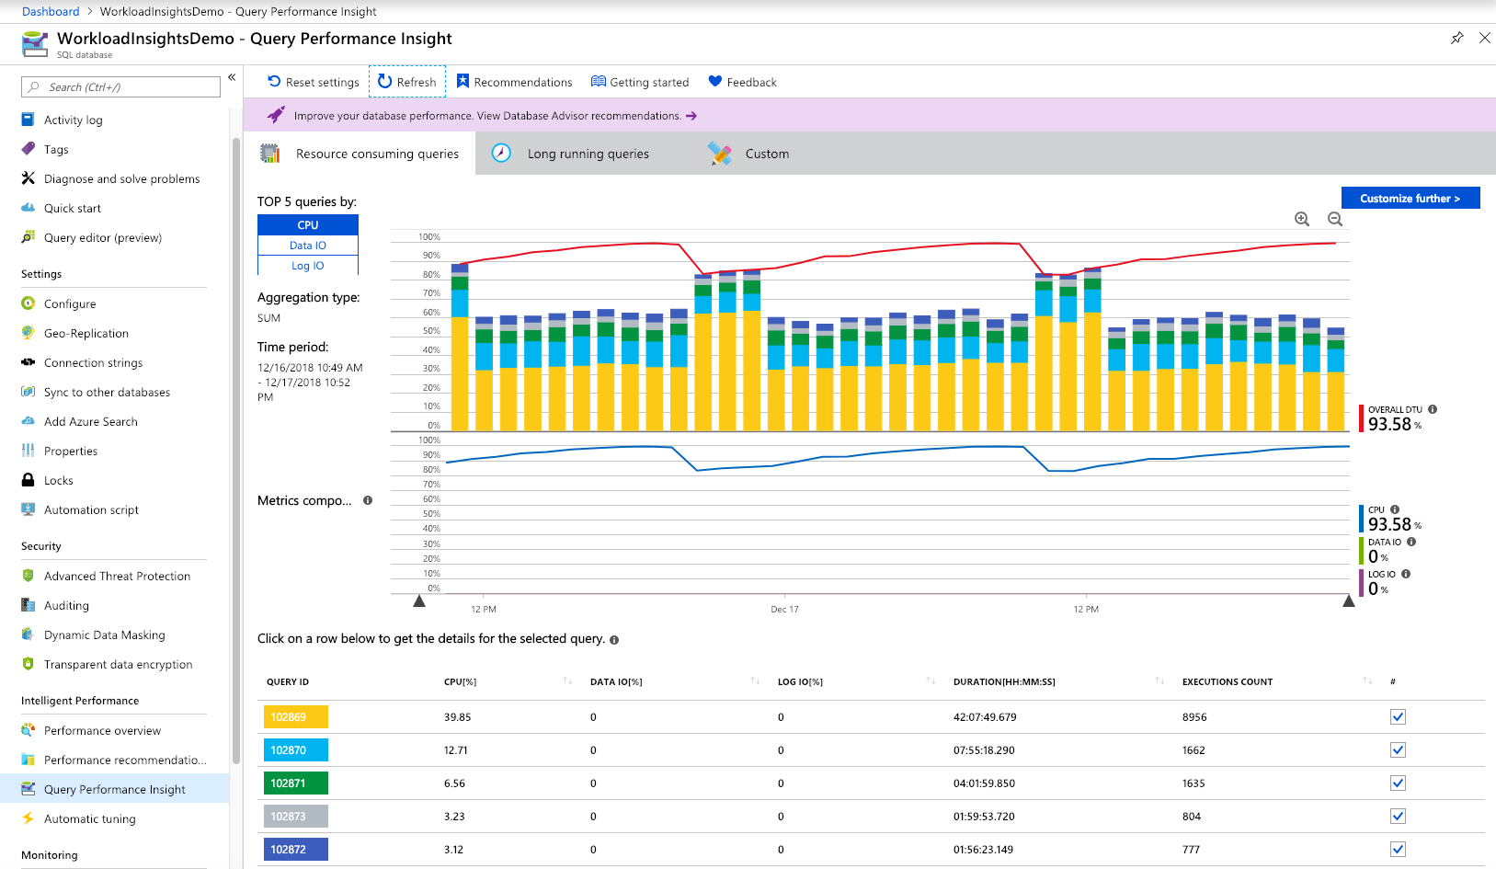

Slide 39
Performance recommendations provided
Create index
Drop index
Parameterize queries (preview)
Enables forced parameterization on the database
Fix schema issues (preview)
Notes:
https://docs.microsoft.com/en-us/azure/sql-database/sql-database-advisor
Create index
High, Medium, Low
If index is implemented and doesn't offer a benefit, will be reverted
Drop index
Duplicate indexes - same key and index columns, filters, and partition schema
Unused for a long period of time (93 days)
Parameterize queries
Will be recommended if queries are constantly recompiled but have the same execution plan
Enables forced parameterization on the database
Fix schema issues
Procedure or function '' expects parameter '', which was not supplied.
Invalid column name '*'.
Invalid object name '*'.
Column name or number of supplied values does not match table definition.
Could not find stored procedure '*'.
Procedure or function * has too many arguments specified.

Slide 40
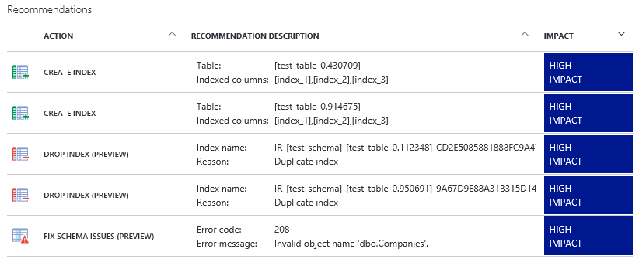

Slide 41
Real life
Using QPI to identify high data usage in Elastic Pool – Jim Donahoe - http://sqlflipflopsdba.com/2017/10/01/using-qpi-to-identify-high-data-usage-in-elastic-pool/
Customer wanted to move from Premium to Standard Elastic Pool
Performance tune existing databases!
Found the top 5 resource-consuming databases
Identified highest data and log I/O queries
Tuning top 3 queries reduced I/O by 10 billion reads
Yes, BILLION!

Slide 42
Demo or screenshots
ostress.exe -Sschultz.database.windows.net -dWideWorldImporters-Standard –U_____ –_____ -i"C:\ostress\Azure_SQL_D_ perf_tuning_ostress_workload.sql“ –n10
View in QPI

Slide 43
Demo
Query Performance Insight
Notes:
My load test should have been run. Open Portal, go to database. On Overview, look at DTU – should be up.
Go to Query Performance Insight.
Show TOP 5 by CPU, Data IO, Log IO
Scroll down to specific queries. Click on the first one.
Can view the query.
Intervals – per hour, what was the number of executions, duration, etc.
What doesn’t it show? Execution plan. I can copy text into SSMS, get Estimated Plan.

Slide 44
Automatic Tuning

Slide 45
Automatic Tuning
Executed queries are monitored for improvements; improvements are applied and measured
If improvement isn't significant, actions are reverted
Automatic index management
Creates useful indexes
Drops duplicate or unused indexes
Automatic plan choice correction
If plan regression is detected, the database will switch to the last known good plan for that query
Notes:
https://docs.microsoft.com/en-us/azure/sql-database/sql-database-automatic-tuning

Slide 46
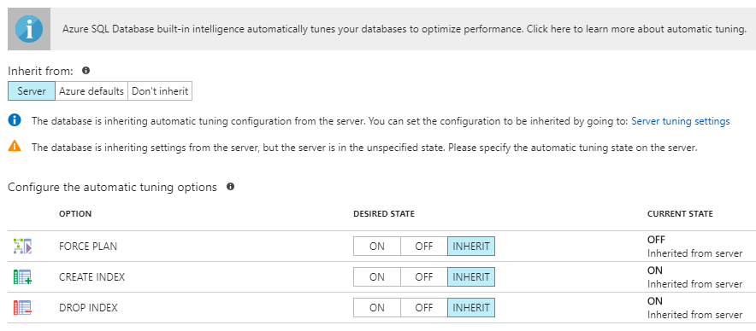
Notes:
Questions I can think of:
Can I figure out what indexes were dropped?
Can I figure out what indexes were auto-created? Are they named something special?
Can I figure out what plans were forced? Yes, using SSMS > Query Store > Forced Plans. DMVs? Not sure
Reference:
AI Tunes SQL DB - https://azure.microsoft.com/en-us/blog/artificial-intelligence-tunes-azure-sql-databases/

Slide 47
Summary

Slide 48
Azure SQL Database
You pay for performance!
Monitor your database for resource consumption because…you pay for performance!
Use rowstore & columnstore indexes to optimize query processing
Use In-Memory OLTP if a workload would benefit from no locks
Scale your database up or down as needed
Use Query Performance Insight to identify expensive queries
Enable Automatic Tuning to fine-tune indexes and execution plans

Slide 49
Jes Schultz Software Engineer Microsoft jes.schultz@microsoft.com @grrl_geek LessThanDot.com

